Slide 1





Intro to Bokeh
Anh Tran
Cheng Chen

Slide 2

A Brief of History of Bokeh
First initial release: April 2013
Current Version: 1.3.4 (Aug 2019). Updated regularly
Current core team: Sarah Bird, Bryan Van de Ven
Currently a popular visualization tool for its benefíta
Notes:
Bokeh prides itself on being a library for interactive data visualization.
Unlike popular counterparts in the Python visualization space, like Matplotlib and Seaborn, Bokeh renders its graphics using HTML and JavaScript. This makes it a great candidate for building web-based dashboards and applications. However, it’s an equally powerful tool for exploring and understanding your data or creating beautiful custom charts for a project or report.

Slide 3

What is Bokeh?
Bokeh is designed to target modern web browsers for presentation over large datasets
Notes:
Bokehs an interactive visualization library that targets modern web browsers for presentation. Bokeh can help anyone who would like to quickly and easily create interactive plots, dashboards, and data applications.
Its goal is to provide elegant, concise construction of versatile graphics, and to extend this capability with high-performance interactivity over very large or streaming datasets

Slide 4
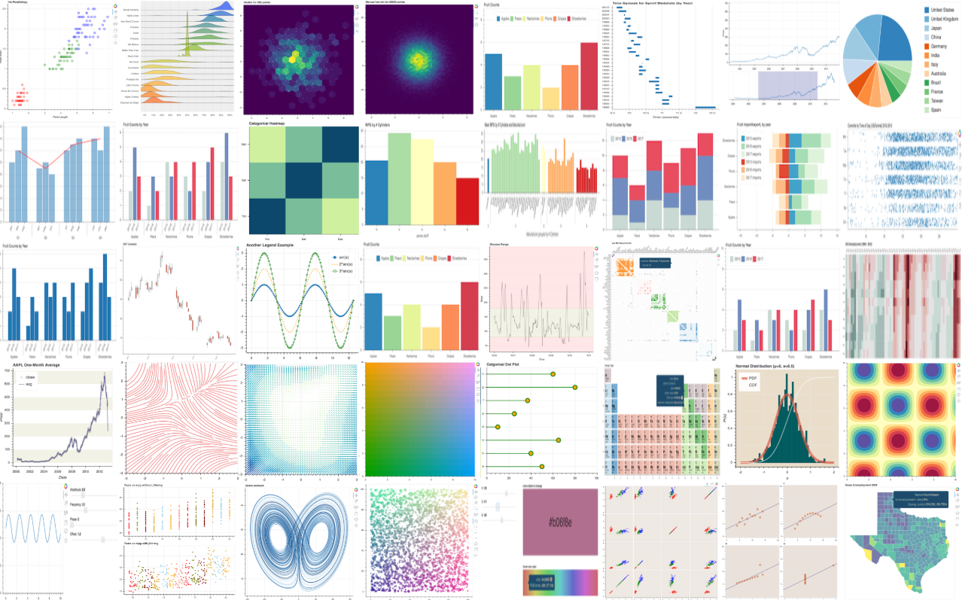

Slide 5
Bokeh vs. Other Interactive Tools
Interactive
Render its graphic using HTML and JavaScript -> Set up and deploy your own visualization server directly and quickly. https://demo.bokeh.org/gapminder
Notes:
What does Bokeh do better than other similar projects?
So I think if you are looking to create interactive visualizations in web browsers, including in Jupyter notebooks, then Bokeh (or Bokeh+Holoviews) is a compelling choice. If you're looking to connect the incredible constellation of PyData tools (e.g. NumPy, SciPy, Pandas, sklearn, etc) to scalable and deployable web "data apps" with a minimum of code even less mucking with "web tech" then I think Bokeh is the clear choice.
Unlike popular counterparts in the Python visualization space, like Matplotlib and Seaborn, Bokeh renders its graphics using HTML and JavaScript. This makes it a great candidate for building web-based dashboards and applications . It can deploy applications directly
If you're looking to connect the incredible constellation of PyData tools (e.g. NumPy, SciPy, Pandas, sklearn, etc) to scalable and deployable web "data apps" with a minimum of code even less mucking with "web tech" then I think Bokeh is the clear choice.

Slide 6
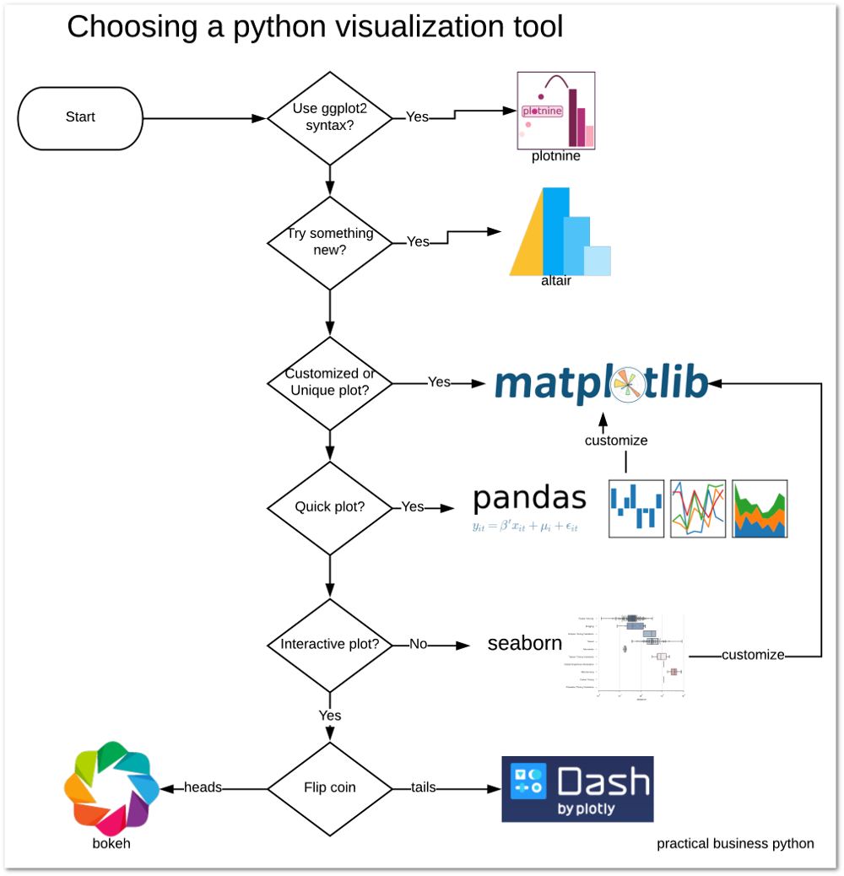
Notes:
if your data is so complex (or you haven't yet found the "message" in your data), then use Bokeh to create interactive visualizations that will allow your viewers to explore the data themselves

Slide 7
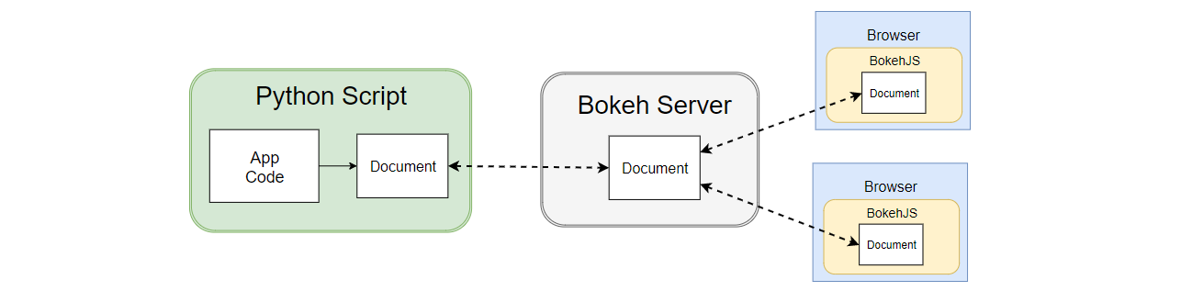
Bokeh Server
Standalone Examples:
Notes:
Purpose¶
The architecture of Bokeh is such that high-level “model objects” (representing things like plots, ranges, axes, glyphs, etc.) are created in Python, and then converted to a JSON format that is consumed by the client library, BokehJS. (See Defining Key Concepts for a more detailed discussion.) By itself, this flexible and decoupled design offers advantages, for instance it is easy to have other languages (R, Scala, Lua, …) drive the exact same Bokeh plots and visualizations in the browser.
However, if it were possible to keep the “model objects” in python and in the browser in sync with one another, then more additional and powerful possibilities immediately open up:
respond to UI and tool events generated in a browser with computations or queries using the full power of python
automatically push server-side updates to the UI (i.e. widgets or plots in a browser)
use periodic, timeout, and asynchronous callbacks to drive streaming updates
This capability to synchronize between python and the browser is the main purpose of the Bokeh Server.

Slide 8
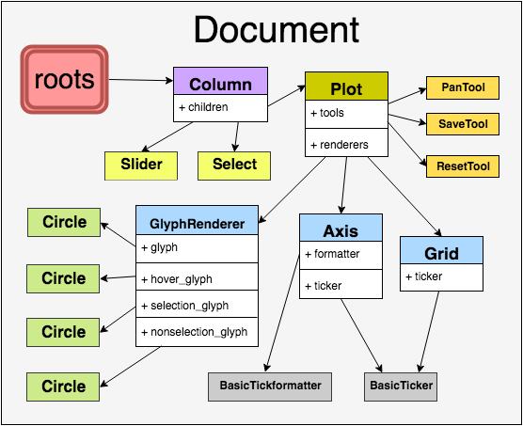
Models and Primitives
Notes:
https://hub-binder.mybinder.ovh/user/bokeh-bokeh-notebooks-2ckkcbif/notebooks/tutorial/A1%20-%20Models%20and%20Primitives.ipynb

Slide 9
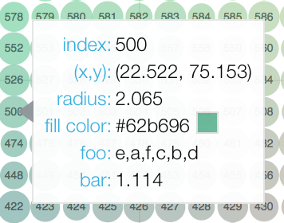
Other Advantages
Bokeh Works Great in Jupyter Notebooks
Themes
Ease of Integration with Pandas (ColumnDataSource)
Exporting to HTML is a Breeze
Intelligent Suggestions on Errors
Easy Interactivity (HoverTool)
Notes:
Boheh works well with Jupyter notebook
The other thing I like to add is a scaling mode when you instantiate the figure as it will fill up the entire notebook window, so you no longer need to specify a size.
Themes: basically let you tell Bokeh “I always want my plot to use size 14 font in the title, hide the ugly grid lines, and always make my axis labels size 12 font and bold”.
I brew a nice cup of coffee and type in import pandas as pd, it’s sort of my morning routine. If you are like me, and live and die with Pandas, then Bokeh is your new best friend. Bokeh uses something called a ColumnDataSource, which while it doesn’t have to be a Pandas dataframe, it works wonderfully with it.
Sharing Bokeh plots with a colleague or on a web application is a breeze as it can be easily exported to something HTML code can use. If you are interested in using these charts in production on a website or sharing them in an HTML file then you should definitely read up on this documentation.
If you put in the wrong command, Bokeh will tell you suggestions for what it think you meant.
the hover tool will generate a “tabular” tooltip where each row contains a label, and its associated value.
https://towardsdatascience.com/6-reasons-i-love-bokeh-for-data-exploration-with-python-a778a2086a95

Slide 10
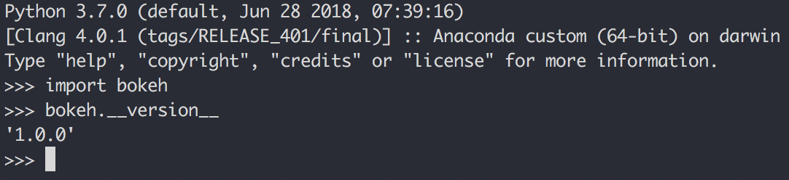
Instal Bokeh:
Bokeh is officially supported (and continuously tested) on CPython versions 2.7 and 3.5+ only.
Require dependencies:
Installation
Verifying Installation
Jinja2 >=2.7
numpy >=1.7.1
packaging >=16.8
pillow >=4.0
python-dateutil >=2.1
PyYAML >=3.10
six >=1.5.2
tornado >=4.3
pip install bokeh
Conda install bokeh
Notes:
Pipenv shell to create an virtual environment.

Slide 11









Bokeh Demo

Slide 12
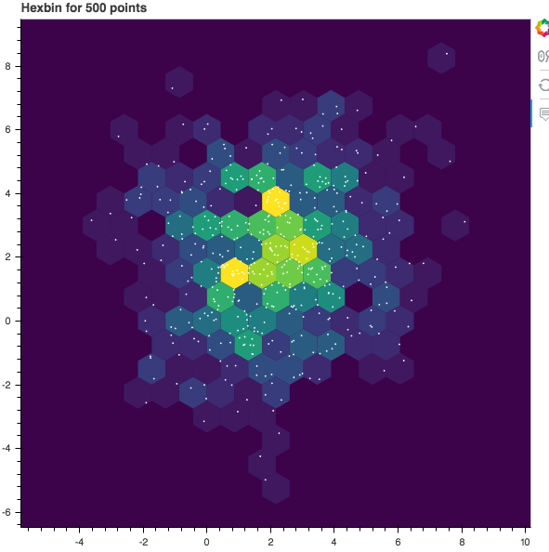
Examples with Jupyter Notebook:
Basic plotting
https://bokeh.pydata.org/en/latest/docs/user_guide/quickstart.html
12 of the Highest Horsepower Cars in the World
https://www.motortrend.com/news/highest-horsepower-sports-cars-100000/
Notes:
https://bokeh.pydata.org/en/latest/docs/gallery.html
https://bokeh.pydata.org/en/latest/docs/user_guide/quickstart.html

Slide 13


Slide 14

Thank you for your attention
Any questions?

Slide 15
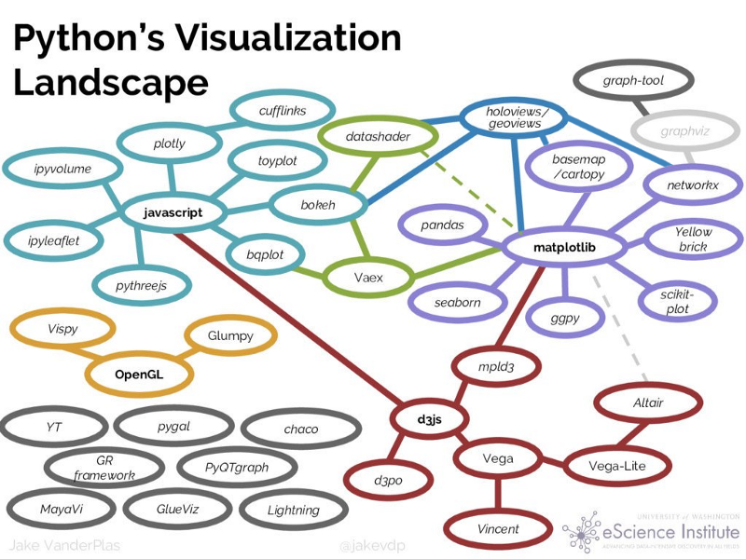
Appendix
https://pbpython.com/visualization-tools-1.html
https://bokeh.pydata.org/en/latest/docs/releases.html
https://bokeh.pydata.org/en/latest/docs/installation.html
https://github.com/bradtraversy/python_bokeh_chart
https://bokeh.pydata.org/en/latest/docs/gallery.html#standalone-examples

